Slide 1

INSTITUTE : UIE
DEPARTMENT: ALL ACADEMIC UNITS
Bachelor of Engineering (All Sections)
Subject Name and Code:
Engineering Physics 23SPH-141
Prepared by: Deepak Kumar, Asso. Prof. Physics
FIBRE OPTICS
DISCOVER . LEARN . EMPOWER

Slide 2
Course Objectives
The course is designed to make the students industry ready to contribute in the growing demand of the industry at local, national and international level.
It will make the students competent to understand basic concepts and applications of advanced engineering physics and apply its principles in their respective fields at global platform.
It will enhance the skill level of the students and shall make them preferred choice for getting employment in industry and research labs.
It will give thorough knowledge of the discipline to enable students to disseminate knowledge in pursuing excellence in academic areas.

Slide 3
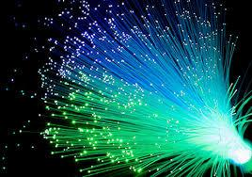
Course Outcomes
CO Number | Title On completion of this course, the students are expected to learn | Level
CO1 | Quote the basic fundamental concepts of lasers, optical fibres, crystallography, ultrasonic oscillations, semiconductor physics, quantum mechanics and nanotechnology. | Remember, Understand
CO2 | Demonstrate the working of various lasers, fibre components, semiconductor devices; explain the behaviour of crystalline solids, quantum and nano-scale systems. | Understand
CO3 | Solve problems by applying principles related to lasers, fibres, semiconductors, oscillations, quantum and nanoscience. | Applying
CO4 | Compare various lasers and fibres, semiconducting devices, crystalline materials, structures at quantum and nanoscale on the basis of their properties for industrial applications. | Analyze
CO5 | Develop various systems using lasers, fibres, semiconductors and nanomaterials for futuristic applications. | Design
Figure 2.1 Optical fibres [1]

Slide 4
Brief Flow of Presentation
Brief Introduction
Optical fiber construction
Critical angle & Total Internal Reflection
Acceptance angle & acceptance cone
Numerical Aperture
V-Number
Types of fibers
Dispersion & its types
Attenuation and Losses in Fiber
Advantages
Disadvantages
Applications
Figure 2.2 Basic structure and parts of optical fibre [2]

Slide 5
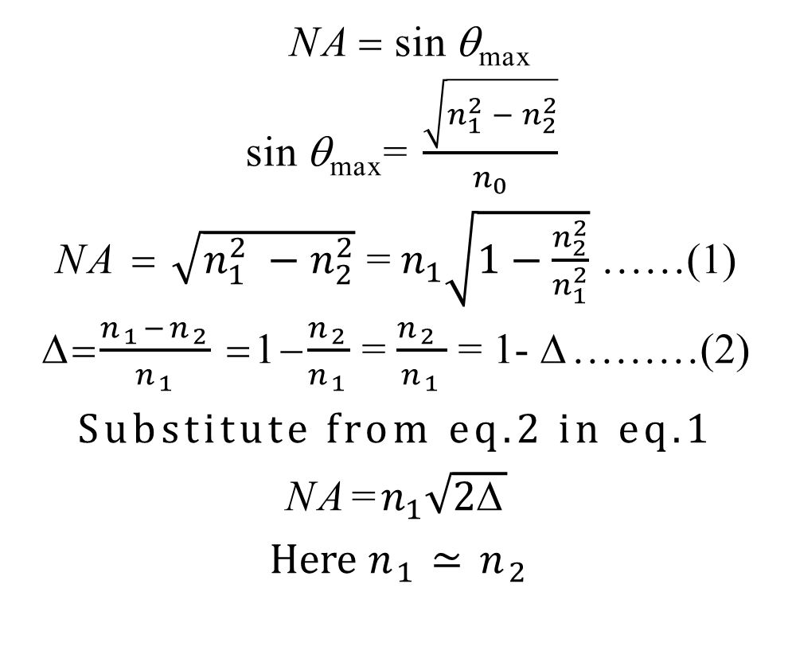
Expression of Numerical Aperture
NA = sin θ_{max}
sin θ_{max}= $\frac{\sqrt{n_{1}^{2} − n_{2}^{2}}}{n_{0}}$
NA = $\sqrt{n_{1}^{2} −n_{2}^{2}}$ = $n_{1}\sqrt{1−\frac{n_{2}^{2}}{n_{1}^{2}}}$ ……(1)
=$\frac{n_{1}−n_{2}}{n_{1}}$ =1−$\frac{n_{2}}{n_{1}}$ = $\frac{n_{2 }}{n_{1}}$ = 1- Δ………(2)
Substitute from eq.2 in eq.1
NA=$n_{1}\sqrt{2\text{Δ}}$
Here $n_{1}≃n_{2}$
Numerical Aperture
It defines gathering capability of fiber mathematically expressed as sine of acceptance angle.

Slide 6
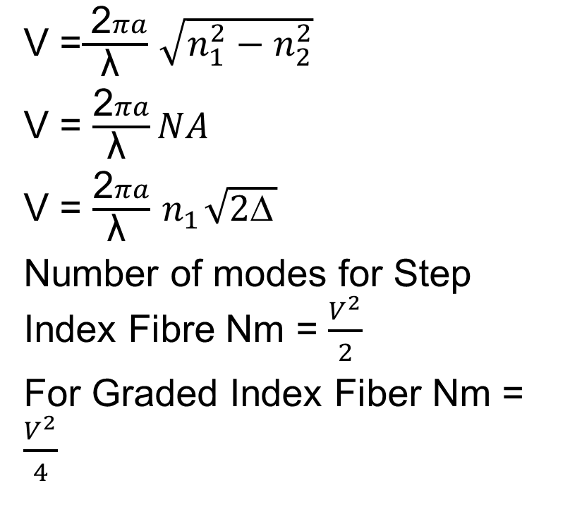
V-number or Normalized Frequency
V =$\frac{ \text{2}πa}{\text{λ} }$ $\sqrt{n_{1}^{2}−n_{2}^{2}}$
V = $\frac{\text{2}πa}{\text{λ} }NA$
V = $\frac{\text{2}πa}{\text{λ} }{ n}_{1}\sqrt{2\text{Δ}}$
Number of modes for Step Index Fibre Nm = $\frac{V^{2}}{2}$
For Graded Index Fiber Nm = $\frac{V^{2}}{4}$
No. of modes supported by optical fiber is obtained by cut-off condition known as normalized frequency or V-Number
V- number can be reduced either by reducing numerical aperture or by reducing diameter of fiber

Slide 7
Normalized frequency is a dimensionless parameter and simply called V-number or value of the fiber.
It combines in a very useful manner the information about three parameters, a, Δ and λ.
Limiting parameter for single and multimode propagation in optical fiber.
⇒ V ≤ 2.405 for Single Mode operation

Slide 8
Summary
Brief Introduction
Optical fiber construction
Critical angle & Total Internal Reflection
Acceptance angle & acceptance cone
Numerical Aperture
V-Number

Slide 9
Assessment Test
Quiz link for Assessment Test:-
https://docs.google.com/forms/d/e/1FAIpQLSdoaR30UPyyOY0IRVyChKPoZVB99BOTYyw61SPEVbYoxNepFQ/viewform?usp=pp_url
Home Assignment :-
Q.1 Give significance of V-Number
Q.2 How number of modes depend on V –Number?

Slide 10
References
[1] https://www.ispreview.co.uk/index.php/2013/07/alcatel-lucent-breaks-record-with-31tbps-over-a-single-fibre-optic-cable.html
[2] http://constructionmanuals.tpub.com/14026/css/Fiber-Buffers-193.htm
[3] https://www.slideshare.net/ankushsaini123/6796optical-fibres
[4] https://www.slideshare.net/MadhumitaTamhane/optical-fiber-communication-part-1- optical-fiber-fundamentals
[5] (a) http://constructionmanuals.tpub.com/14026/css/Fiber-Buffers-193.htm
(b) https://computer.howstuffworks.com/fiber-optic2.htm
[6] https://www.slideshare.net/PratyushSrivastava8/optical-fiber-cable- v2?from_action=save
[7] https://www.ques10.com/p/21598/derive-the-expression-of-numerical-aperture- for-a-/
[8] https://www.explainthatstuff.com/fiberoptics.html
[9] http://fiberonda.com/single-mode-vs-multi-mode-fiber-optic-cable/
[10] https://images.app.goo.gl/LLWfgV3PjgLc9RbDA

Slide 11
Text book
Beiser A., Ghatak A, Garg S.C., Applied Physics, Edition 1st, (2013), Tata McGraw-Hill, Noida.
Laud B.B., Laser and Non -Linear Optics, Edition 1st, (1991), Wiley Eastern Ltd.
E- content
http://www.fiberopticshare.com/what-are-the-components-of-optical-fiber.html

Slide 12
THANK YOU
For Queries:-
deepak.e1972@cumail.in

